Slide 1
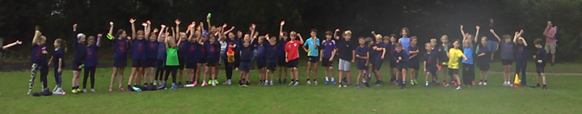
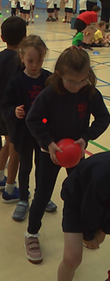
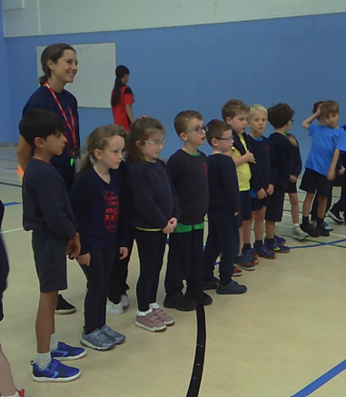
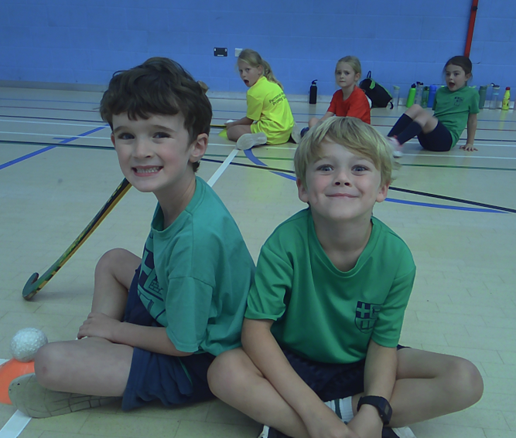
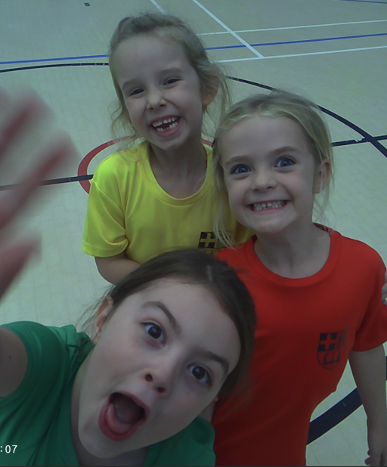
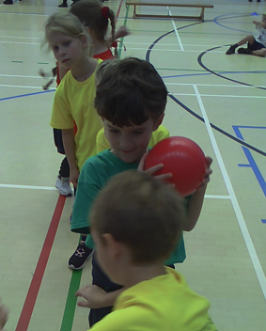
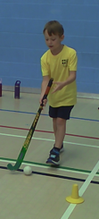
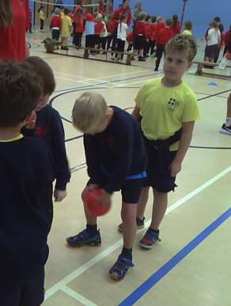
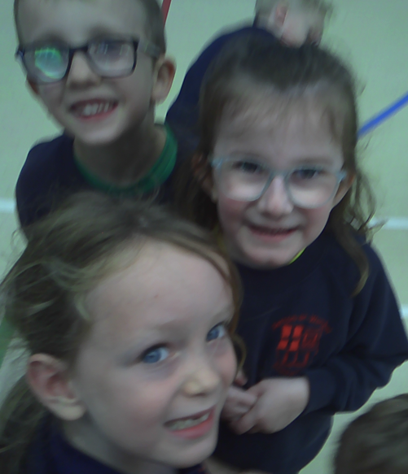
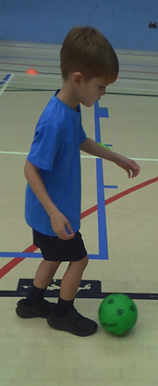
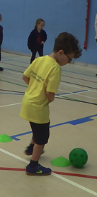
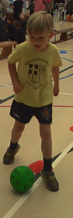
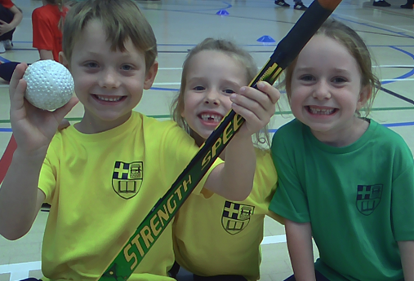
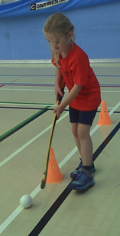
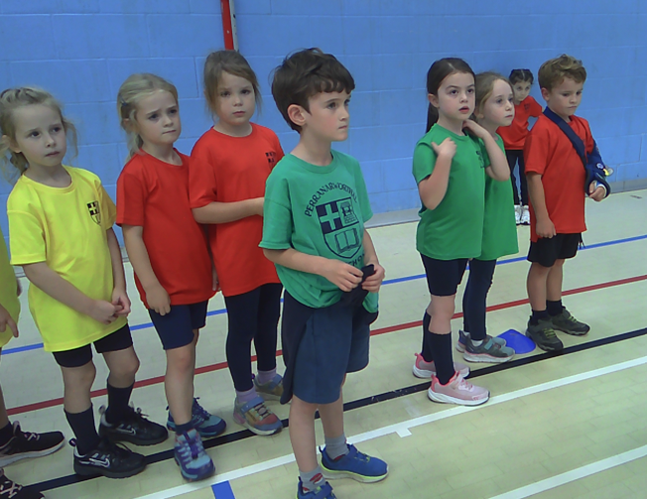
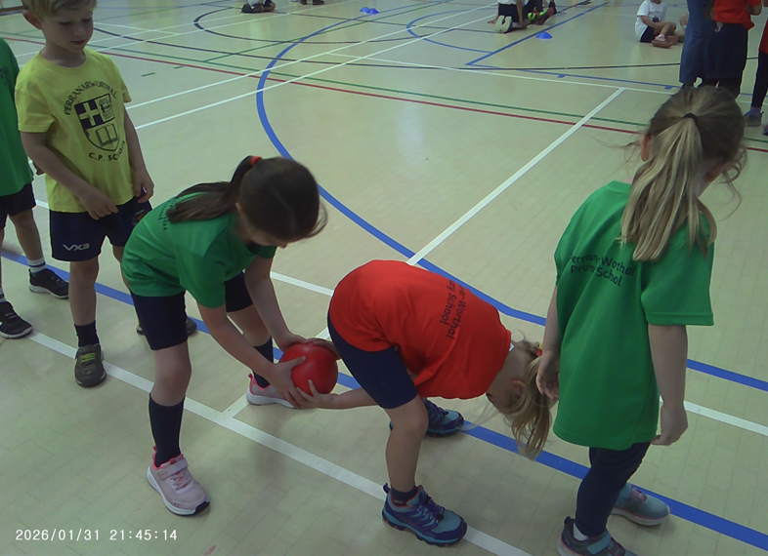
P.A.W.sitive Game Day Gazette. Issue # 1
First cross-country session September 2026
I do believe that Perran-ar-Worthal children beat our record for Friday morning’s running session. We had an amazing 45 runners, nearly a quarter of the school, challenging themselves and encouraging each other. Thank you to all the parents that helped us cross the road safely and for supporting all these children with their running!
KS1 Multi-skills event.
Robins travelled to Penryn College on Friday afternoon for a multi-skills event. Representing the school at Penryn College can seem quite daunting. Every child rose to the challenge, working as part of a team, encouraging their friends and doing their best!
Robins faced football challenges, hockey dribbling courses, team building hoop races, under and over teamwork, overarm shuttlecock throwing and balancing a tennis ball on a racket. They focussed and improved as they practiced.

Slide 2
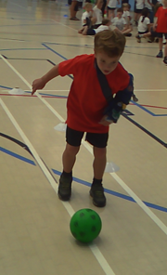
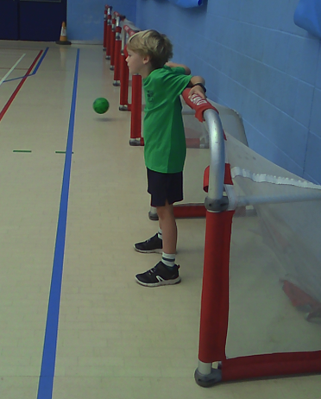
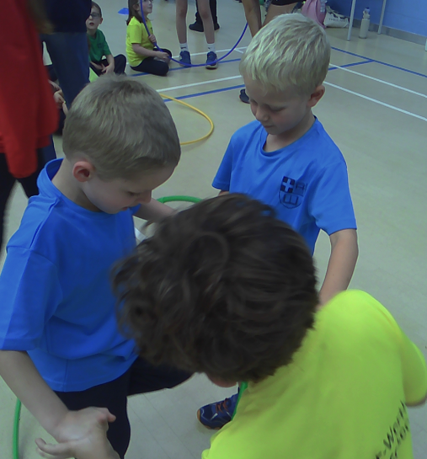
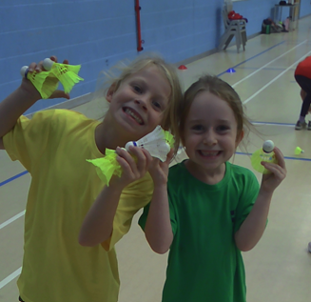
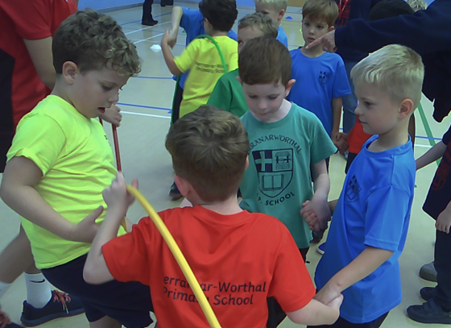
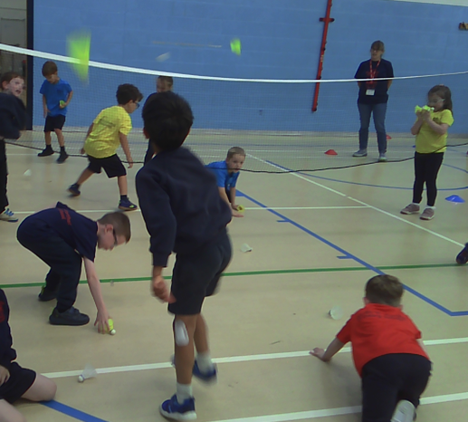
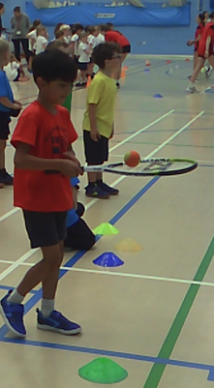

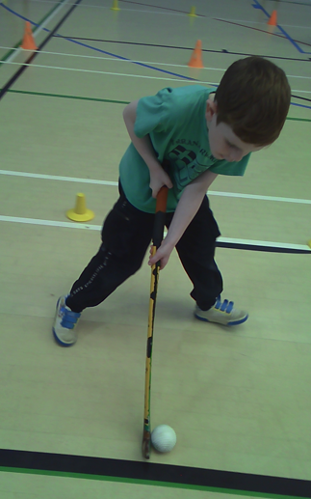
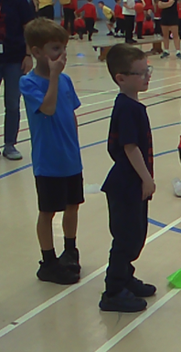
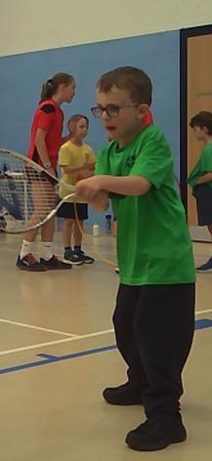
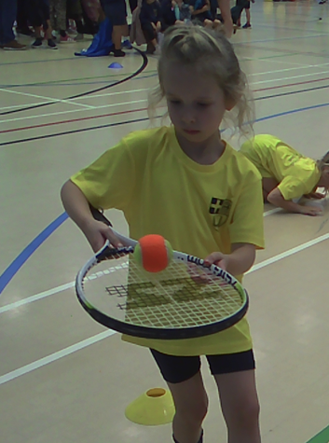
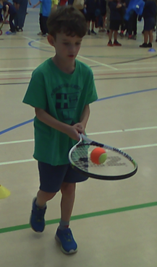
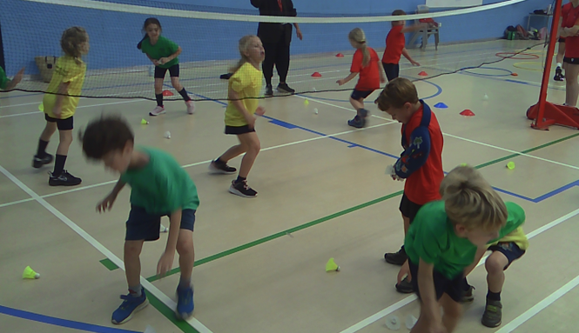
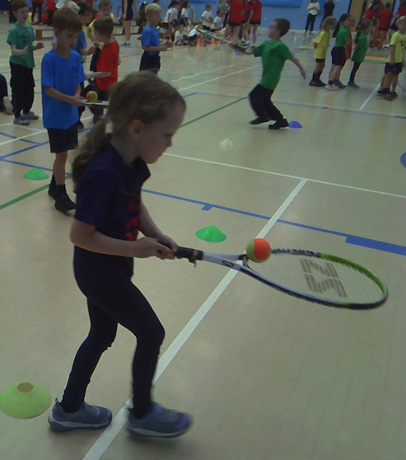
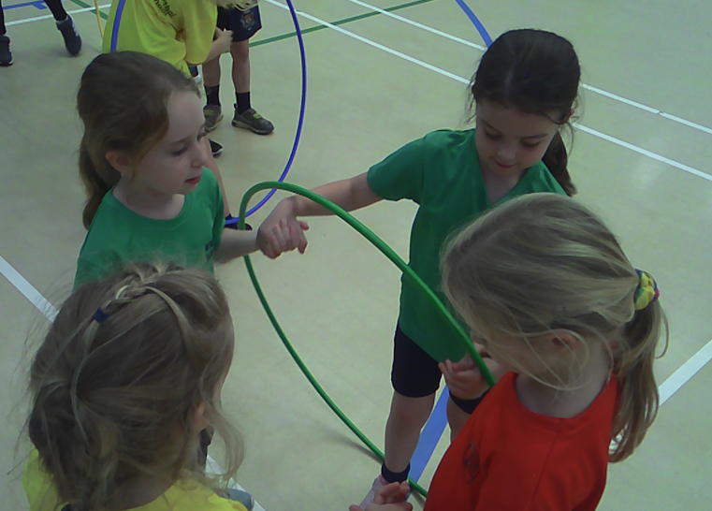
Teamwork
Encouragement
Skill
Robins
Resilience
A huge thank you to Mrs Nicholson, Mrs Hamilton, Mrs Parker Natalie, Roberta, and Nadine for all of your help.

Slide 3

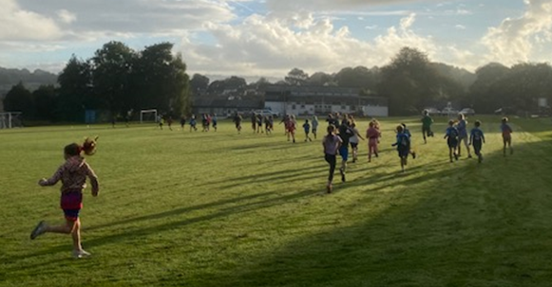
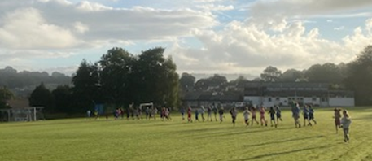
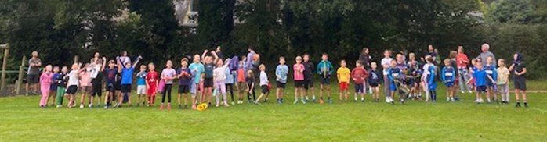

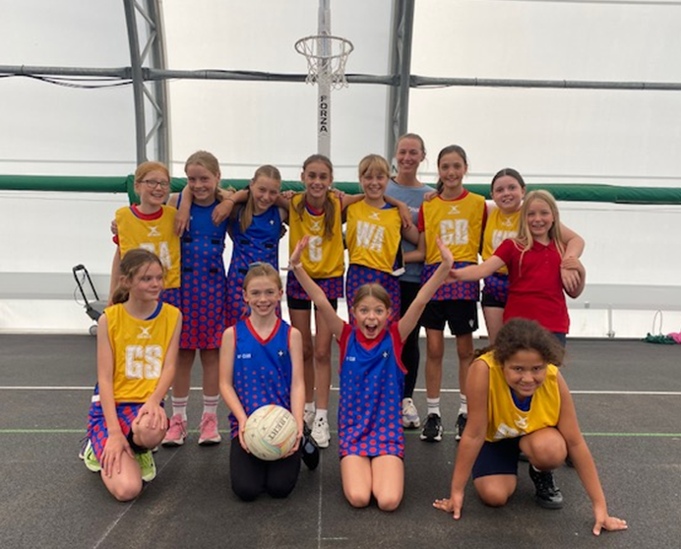

Week 2 - cross-country
September 2026
And we beat the record! –what a beautiful morning for our 47 runners on Friday!
The challenge was to try and just slow down and not stop whilst running! They did well! Well done!
Year 6 Netball Leagues September 2026
A win and a draw in our first netball league!
At Perran-ar-Worthal, PE behaviour attributes are taught and celebrated. These girls showed them all; resilience, sportpersonship. respect, personal best, passion & cooperation.
Perran-ar-Worthal faced two other schools last Wednesday; Constantine & Kennal Vale. The first week is always quite nerve-wracking, but these girls fell into a fantastic rhythm and created quick successful passing patterns. Our calm and collected GS, scored 9 shots in the first match. The second match was a bit more intense, with our girls having to take some challenging referee calls. To be able to show this amount of sportspersonship at this age is a credit to these girls! Thank you so much to Katherine and our deputy coach Ember for all your coaching tips encouragement and support! Well done girls!

Slide 4

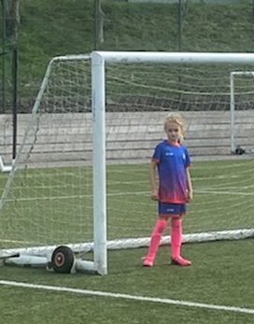
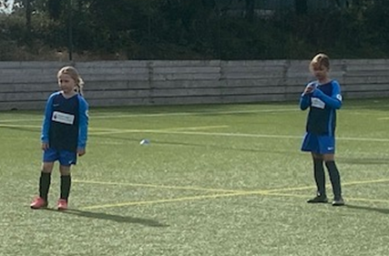
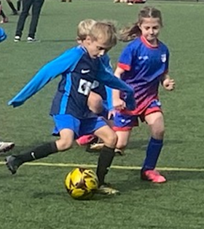
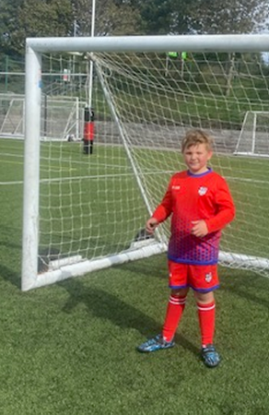
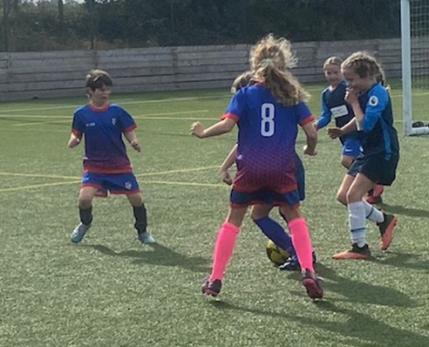
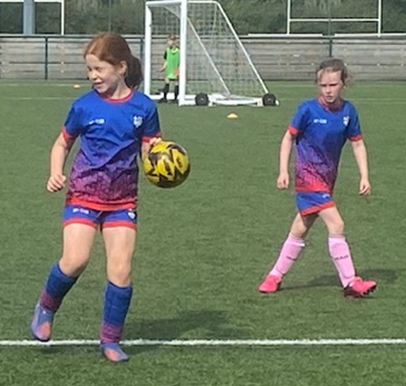
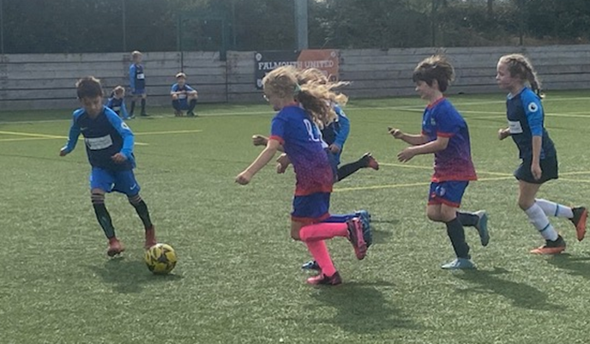
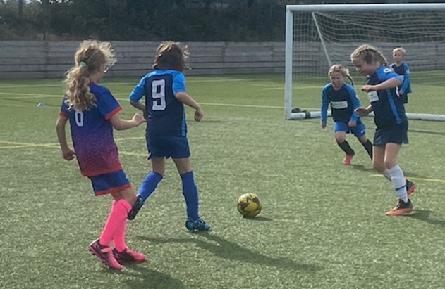
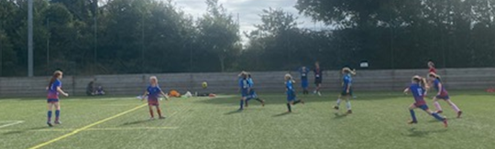
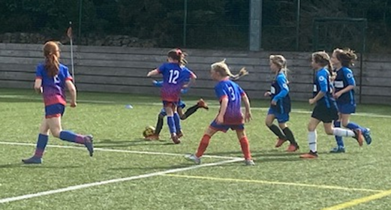
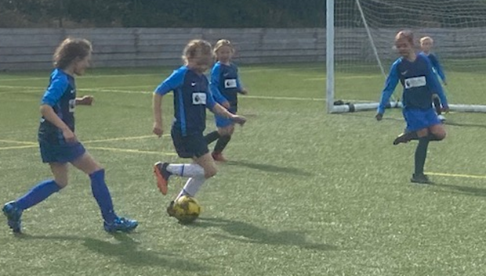
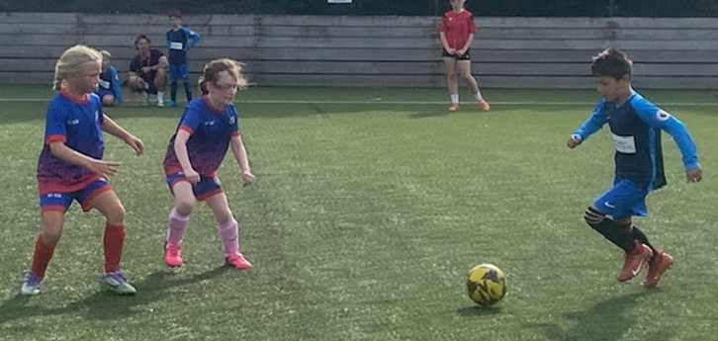
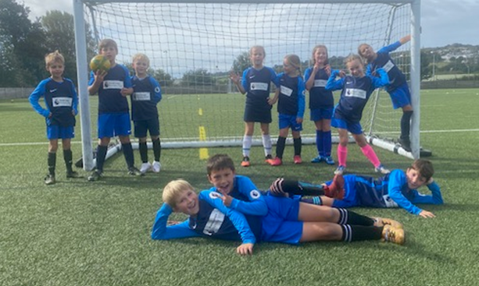

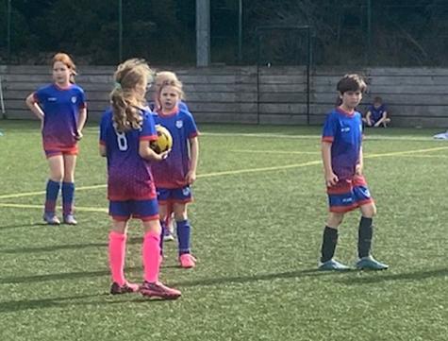
Year 4 football qualifier.
September 2026
This must be one of the best events in the year – an opportunity for children to develop their football skills in mini competition on Penryn’s STP. These year 4 children blew us all away with their skills and courageous play! Their skills and teamwork developed over the morning with a few wins, a few matches lost and then a game of our two teams versing each other! It was a fantastic morning of football. Well done to all players! Thank you so much to Mrs Nicholson and Mr Lampard for your coaching, encouragement and support of these amazing children!

Slide 5
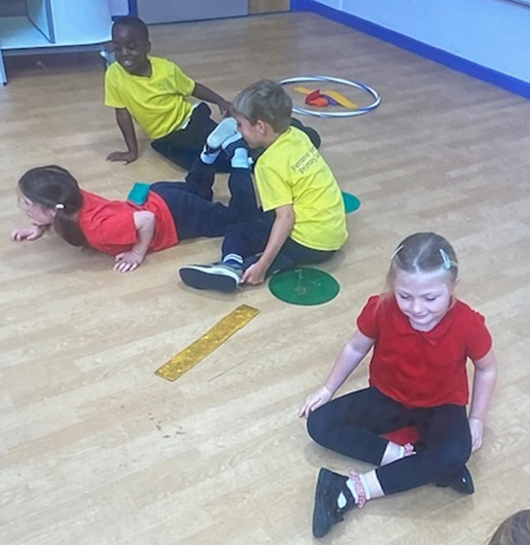









Teamwork in Wagtails:
making monster soup!
T
E
A
M
W
O
R
K
Wagtails have started the term working on teamwork. They have been moving using spatial awareness, learning to take turns and making monster soup as part of a team. They encourage each other and build one another up.
Well done Wagtails.

